Slide 1
Healthy Relationships: Part 1
Grade 7 & 8
Presentation adapted with permissions from Middlesex-London Health Unit
Notes:
NOTE to Teachers: This presentation is Part 1 of a 2 part series, you can access the second presentation “Healthy Relationships and Social Media” and other MLHU presentations at https://www.healthunit.com/healthy-schools-teaching-resources#human-development-and-sexual-health
Image from: https://pixabay.com/
D2.4 demonstrate an understanding of physical, emotional, social, and psychological factors that need to be considered when making decisions related to sexual health (e.g., sexually transmitted infections [STIs], possible contraceptive side effects, pregnancy, protective value of vaccinations, social labelling, gender identity, sexual orientation, self-concept issues, relationships, desire, pleasure, cultural teachings) [PS]
D3.3 explain how relationships with others (e.g., family, peers) and sexual health may be affected by the physical and emotional changes associated with puberty (e.g., effect of physical maturation and emotional changes on family relationships, interest in intimate relationships and effect on peer relationships, risk of STIs and/or pregnancy with sexual contact) [IS, CT]201 GRA D E 7 HEALTHY LIVING
Teacher prompt: “How can the changes experienced in puberty affect relationships with family and others?”
Student: “Adolescents may be interested in having a boyfriend/girlfriend. They may feel ‘grown up’, but still get treated like a kid, and
GRADE 8
D1.4 identify and explain factors that can affect an individual’s decisions about sexual activity (e.g., previous thinking about reasons to wait, including making a choice to delay sexual activity and establishing personal limits; perceived personal readiness; peer pressure; desire; curiosity; self-concept; awareness and acceptance of gender identity and sexual orientation; physical or cognitive disabilities and possible associated assumptions; legal concerns; awareness of health risks, including risk of STIs and blood-borne infections; concerns about risk of pregnancy; use of alcohol or drugs; personal or family values; religious beliefs; cultural teachings; access to information; media messages), and identify sources of support regarding sexual health (e.g., a health professional [doctor, nurse, public health practitioner], a community elder, a teacher, a religious leader, a parent or other trusted adult, a reputable website) [PS]
Teacher prompt: “How would thinking about your personal limits and making a personal plan influence decisions you may choose to make about sexual activity?”
D1.5 demonstrate an understanding of gender identity (e.g., male, female, two-spirited, transgender, transsexual, intersex), gender expression, and sexual orientation (e.g., heterosexual, gay, lesbian, bisexual), and identify factors that can help individuals of all identities and orientations develop a positive self-concept [PS]
Teacher prompt: “Gender identity refers to a person’s internal sense or feeling of being male or female, which may or may not be the same as the person’s biological sex. It is different from and does not determine a person’s sexual orientation. Sexual orientation refers to a person’s sense of affection and sexual attraction for people of the same sex, the opposite sex, or both sexes. Gender expression refers to how you demonstrate your gender (based on traditional gender roles) through the ways you act, dress, and behave. Gender identity, gender expression, and sexual orientation are connected to the way you see yourself and to your interactions with others. Understanding and accepting your gender identity and your sexual orientation can have a strong impact on the development of your self-concept. A person’s self-concept can develop positively if the person understands and accepts their gender identity and sexual orientation and is accepted by family and community. It is harder to develop a positive self-concept, however, if the way a person feels or identifies does not meet perceived or real societal norms and expectations or is not what they want, or if they do not feel supported by their family, friends, school, or community. A person’s self-concept can be harmed if a person is questioning their gender identity or sexual orientation and does not have support in dealing with their feelings of uncertainty. What kind of support do people need to help them understand and accept their gender identity and sexual orientation?”
Student: “Having role models that you can relate to – for example, people of similar ages or cultures – is important. So is having all gender identities and sexual orientations portrayed positively in the media, in literature, and in materials we use at school. Family, school, and community support are crucial. Additional help can come from trusted adults, community organizations, and school support groups such as gay-straight alliances.”

Slide 2
Ground Rules
Giggling is OK
No names or specific examples of peers will be used in discussions.
Respect what others say
Understand others’ feelings
Discuss relationship topics responsibly outside the classroom
There are no dumb questions
Notes:
Open discussion and allow the class to add any other ground rules

Slide 3
Types of relationships
Throughout our lives, we are involved in many different kinds of relationships. These include:
Parents
Siblings/relatives
Friends
Girlfriends/boyfriends
Teachers and classmates
Healthy relationships can make us happier and add to our feelings of self-worth

Slide 4
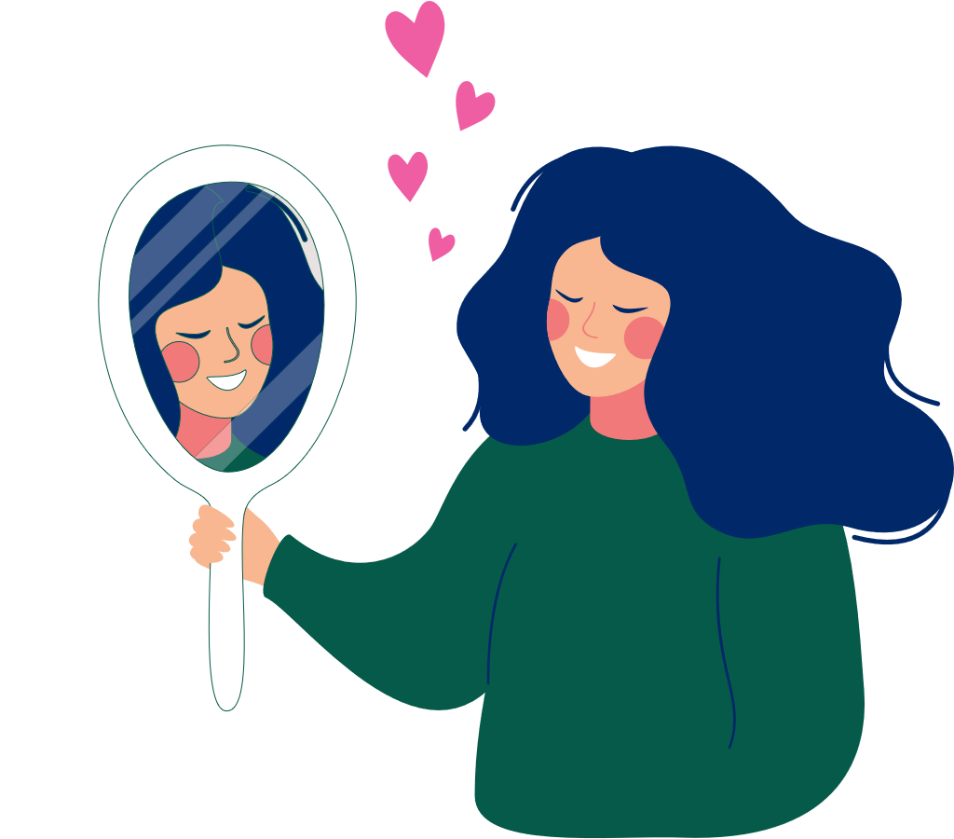
Healthy Relationships
Starts with yourself
It’s good to see yourself in a positive way
We all have strengths and things we want to work on
Thinking positively about yourself can help with relating to others
This can contribute to healthy relationships

Slide 5
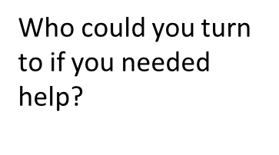
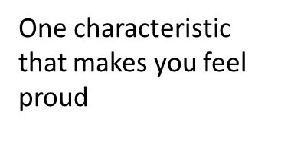
Looking at Myself
Notes:
“Looking at Myself”
Students trace their hand and number fingers for corresponding 5 questions:
Name one characteristic about yourself that makes you feel proud
What is your strongest, positive personality trait?
List one thing you would like to change or improve about yourself
What is your best physical characteristic?
Who could you turn to if you needed help?
- This is yours to keep; you do not need to show anyone. Was this difficult? What would others say?

Slide 6
How do you start a relationship?
Showing the other person that you are interested in getting to know them
smiling
laughing
actively listening to them
Talk about interests and find what things you have in common
playing sports
play an instrument/music
movies

Slide 7
In a Healthy Relationship:
Both people want to be in the relationship
both people feel good
brings out the best in each other
Each partner tries to help the other if they are able to do so
Both people are comfortable being themselves
Each partner brings out the positives in the other
Talents
Strengths
Notes:
Notice that each of these qualities can be found in positive friendships and romantic relationships.

Slide 8
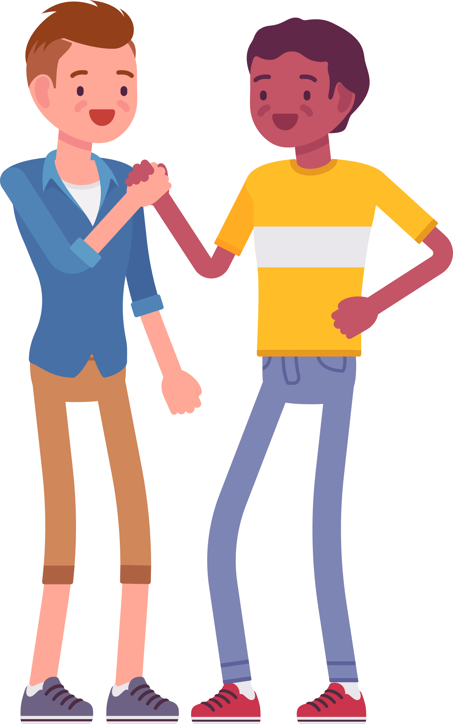
People in Healthy Relationships:
Talk with each other easily
Trust each other
Respect each other
Are honest
Laugh together
Accept differences
Share similar interests
Are able to respectfully work through disagreements

Slide 9
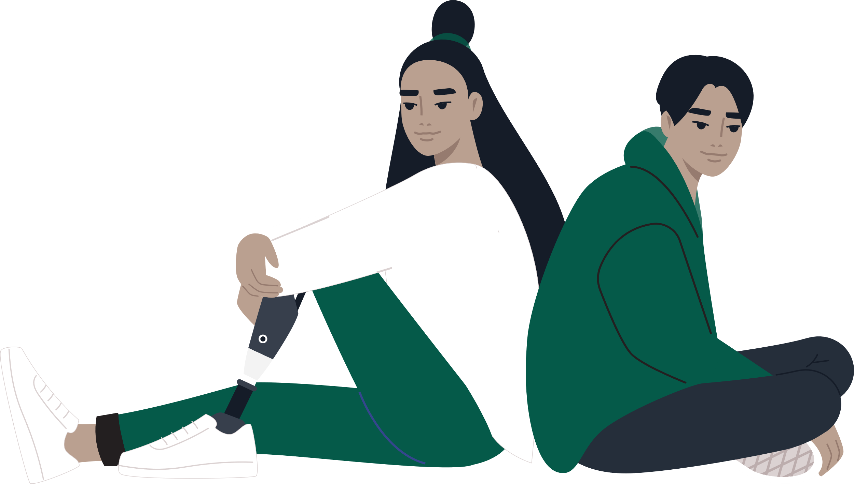
Discussion
What would be an example of an unhealthy relationship?
What is important to you in a relationship?
What are some ways people can show these qualities in a relationship?
Notes:
Remind students that they can think of examples from their relationships with family, friends and classmates.
Refresher but applicable: Grade 6 Curriculum connect D 2.6: In many ways, dating or intimate relationships can be similar to other relationships, such as those with friends or family. Relationships we see online or in the media are not always accurate and can send false messages. What are some of the signs of a healthy relationship, and what are some signs of trouble?
How can you help a friend who may be in an unhealthy relationship?
In a healthy relationship, people show respect and care for each other. They try to communicate well and are honest with each other. When someone in a relationship is jealous, controlling, or abusive, or does anything that makes you feel uncomfortable, this is a sign of trouble. Sometimes a relationship can start out as healthy but become unhealthy.
If I saw this happening to a friend of mine, I would talk to them about what I am noticing, listen to their response without judgment, and encourage them to seek help when needed. I would also try to get them help from a parent, teacher, or a help line.

Slide 10
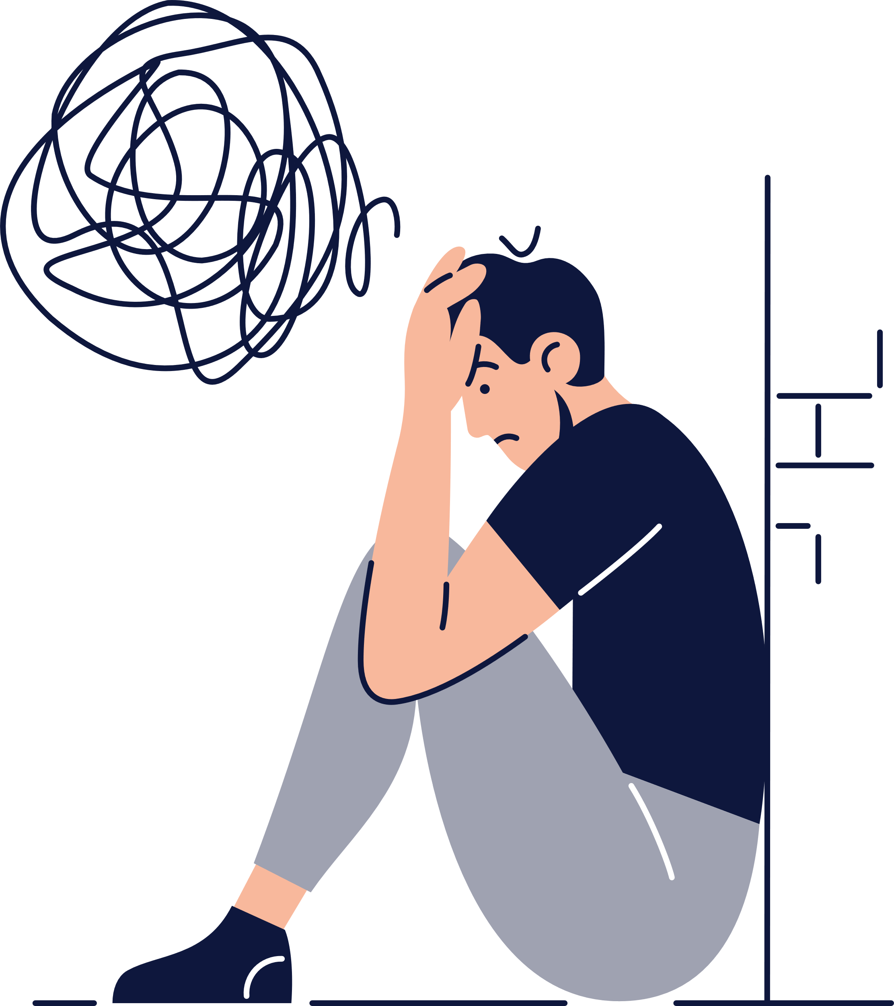
If you have feelings of uncertainty, doubt, or fear about a relationship, it is important to recognize and act on these feelings
Don’t force yourself to be in a relationship you don’t want to be in
Notes:
Where can students go for help:
Talk to someone you trust like a parent or teacher
Kids Helpline 1-800-668-686
www.NeedHelpNow.ca * Keep in mind information shared online is public and permanent, but if you have had something posted online that you want to try and remove you can go to this website to try and minimize damage/take back control.

Slide 11
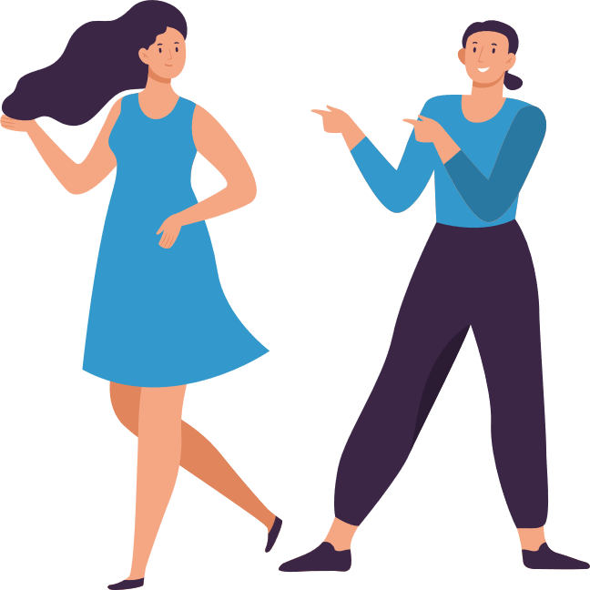
Communication in Relationships
If you share common interests and like each other:
How can you get to know each other better?
Notes:
How can you get to know each other better? – class discussion
You may wish to highlight:
Let relationships progress naturally (Don’t impose yourself on others)
Sometimes through no fault of our own people don’t click, don’t take it personally
Don’t let it get you down, look for other opportunities to make new friends
Sometimes friends and romantic relationships start and end, this is common and we can chose to think of the relationships in a positive way, such as what we learned from the relationship??

Slide 12
How can the changes experienced during puberty affect relationships?
Notes:
Involvement and relationship with parents (want more independence)
Peer relationships (time spent with friends, friends opinions about relationships)
Sexual interest/contact

Slide 13
Consent
YES
NO
Consent means willingly giving permission through words or actions for something to happen
Consent must be informed and explicitly stated.
Silence is not consent.
If an individual does not say “yes”, it must be assumed that she/he is saying “no”
Notes:
Image from: https://pixabay.com/en/yes-consent-ticked-off-box-cross-238373/

Slide 14
Age of sexual consent
16 years and older can consent to sexual activity
14 and 15: “can consent to sexual activity with a person who is less than 5 years older*”
12 and 13: “can consent to sexual activity with a person who is less than 2 years older*”
*Except with a person in position of authority
Examples:
Doctor/Nurse
Family member
Teacher
Camp Councilor
Notes:
Reference: Summary or age based legal milestones for youth in Ontario. Justice for Children and Youth
Image from: https://pixabay.com/en/hammer-court-law-judge-justice-1709118/

Slide 15
Wrapping Up
Remember:
A healthy relationship starts with how you feel about yourself.
Be aware of how media messages can affect how you feel about yourself, and your relationships is important.
Be true to yourself and keep people in your life who make you feel good.
If you are having concerns about a friendship or relationship talk to someone you trust.

Slide 16
Questions

