Slide 1
Healthy Relationships and Social Media Part 2
Grade 7 & 8
Presentation adapted with permissions from Middlesex-London Health Unit
Notes:
NOTE to Teachers: This presentation is Part 2 of a 2 part series.
You can access the first presentation “Healthy Relationships” and others at HNHU.org

Slide 2
Ground Rules
Giggling is OK
No names or specific examples of peers will be used in discussions.
Respect what others say
Understand others’ feelings
Discuss relationship topics responsibly outside the classroom
There are no dumb questions
Notes:
All students to identify/add their own ground rules

Slide 3
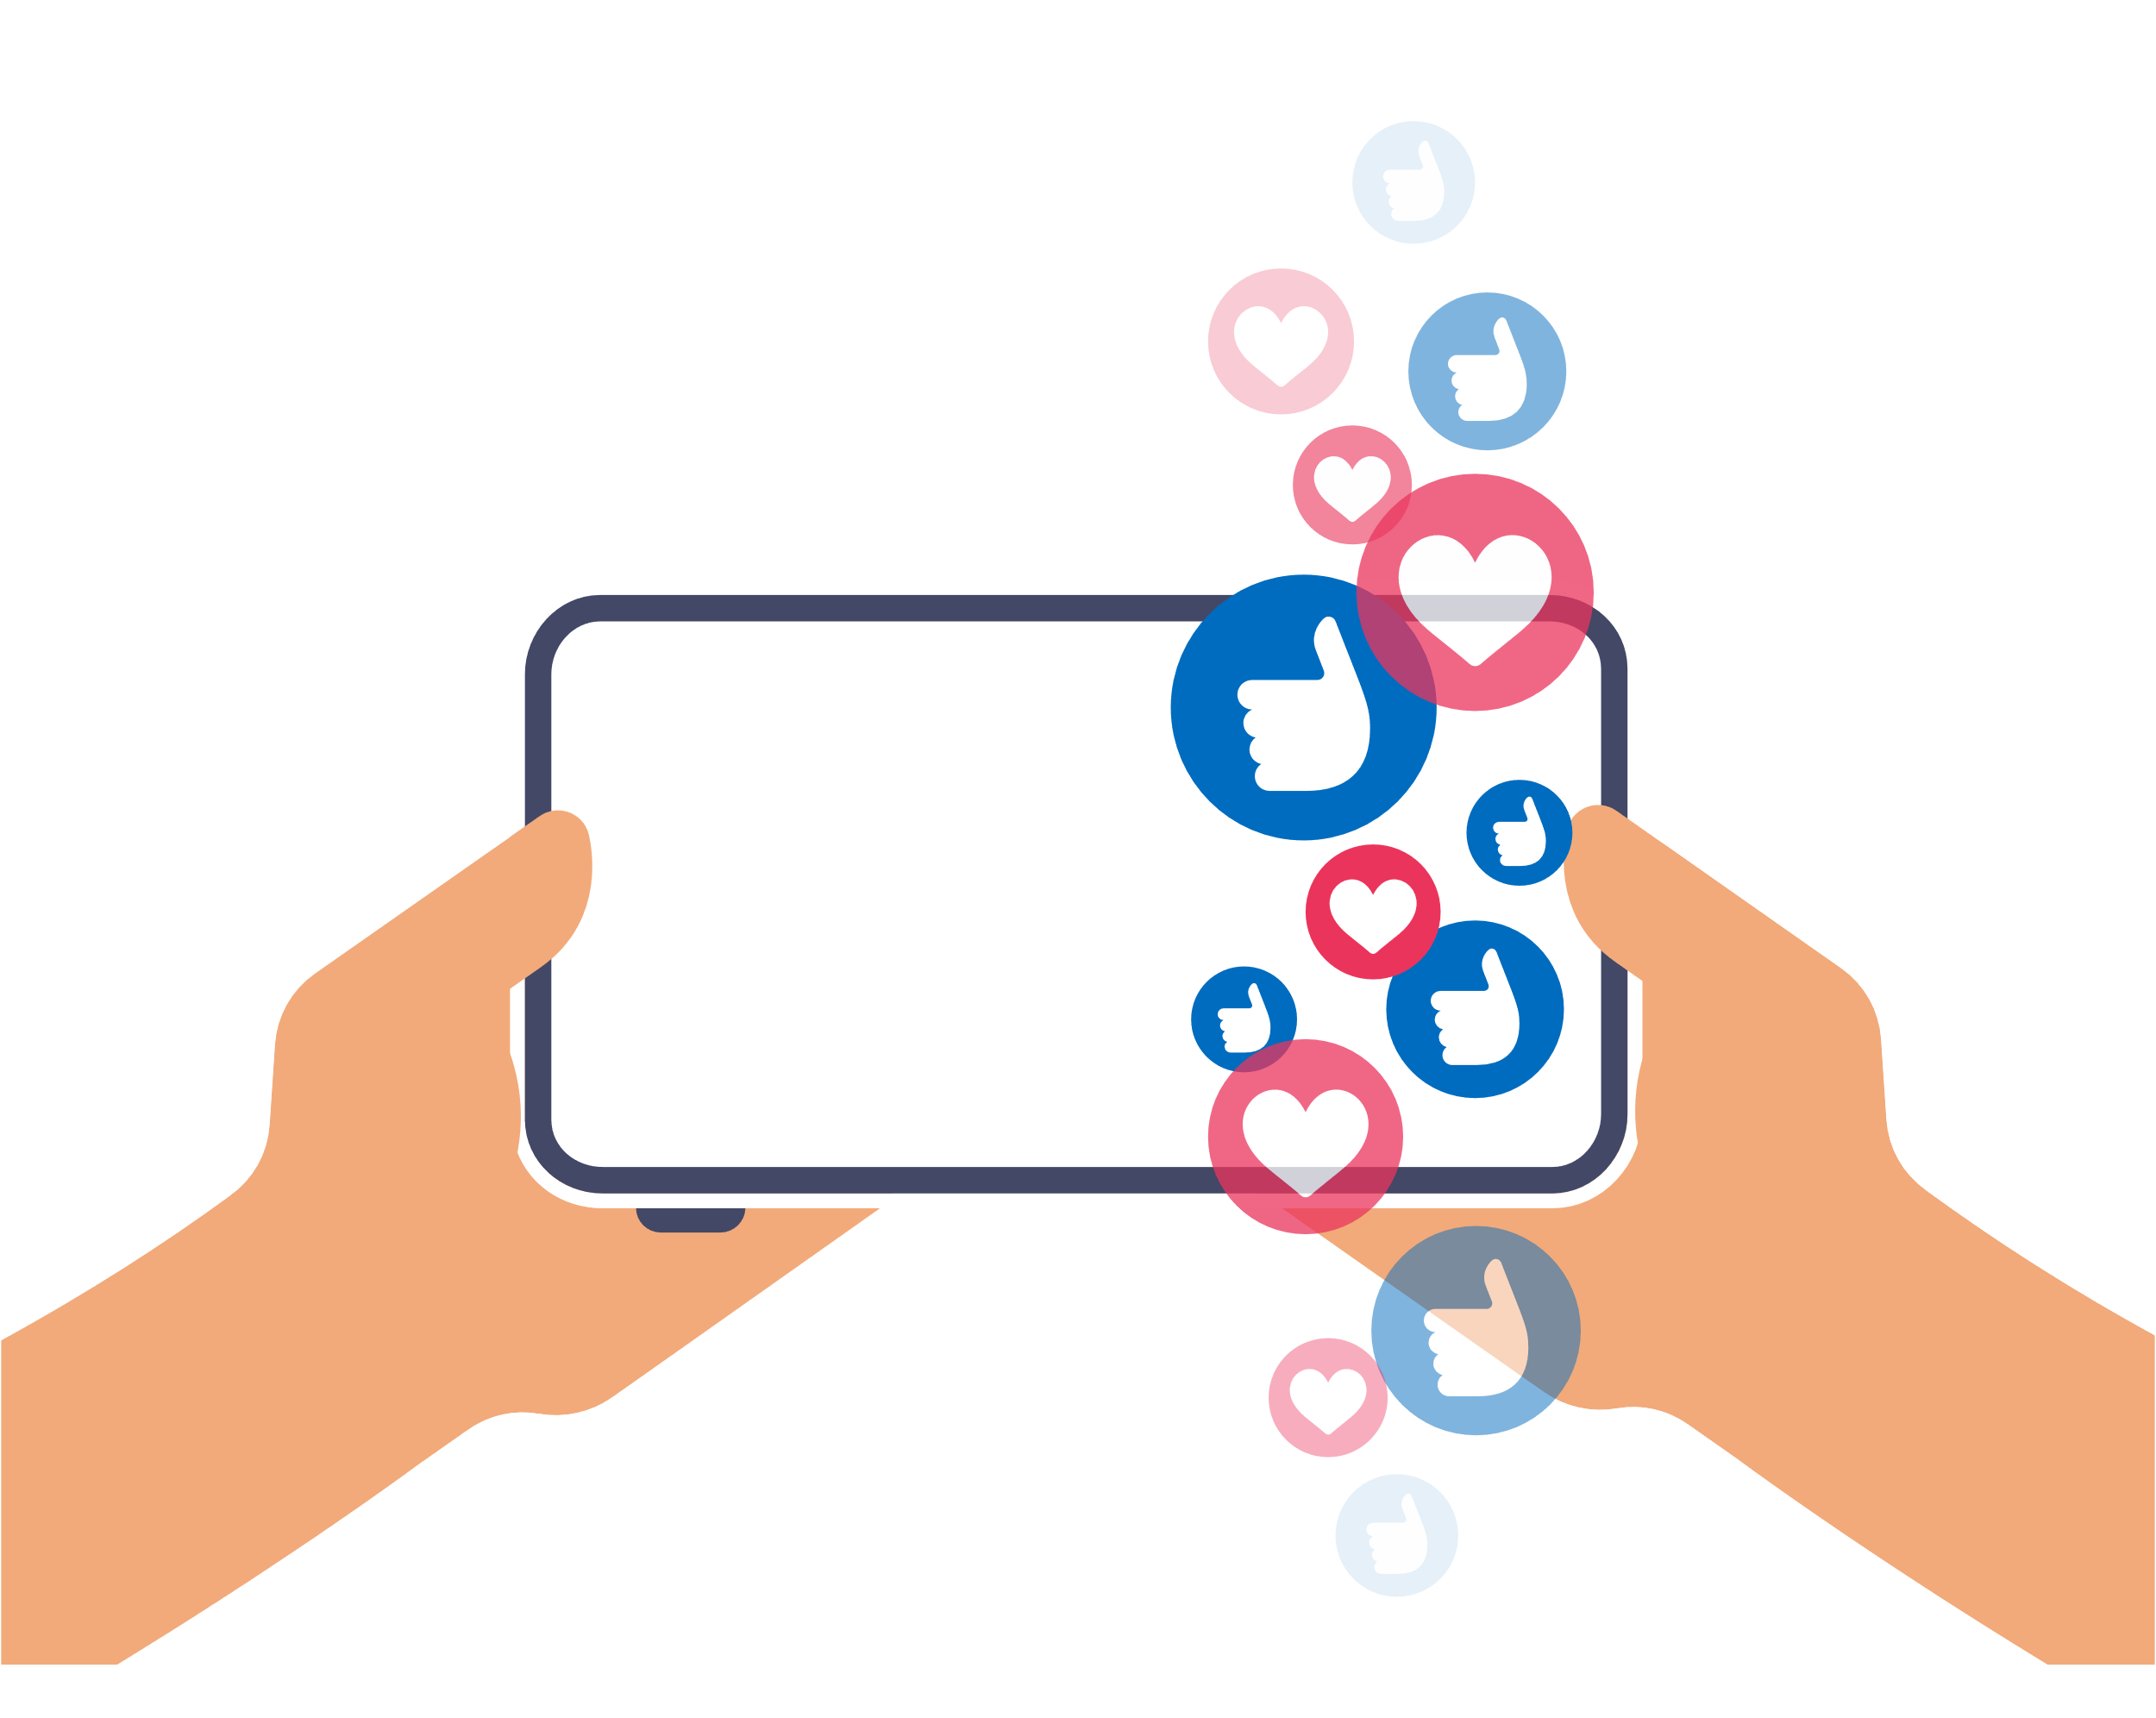
Media’s Influence
What does media do for us?
Let’s talk about the ways the media* can affect the way we:
Think about ourselves/others
Feel about ourselves/others
Act around others
Notes:
What are some positives/ benefits of media/ technology? (ex. Saves time, improved/ quick communication, wide/ global access)
How is media/ technology dangerous? (ex. Misuse of private information, identity theft, addiction/ time, potential for gambling, misinterpretation, distracted driving)
*May prompt discussion by asking what are the types of media?
-includes all of the following: TV, online including all social media, gaming, advertisements
Suggested Activities:
OPHEA Health and Physical Education Grade 8. Sexuality Values in our Music. Page. 222.
Students choose a song to analyze lyrics as a class or individually.
Example Question: Do you think the song sends a positive or negative message about relationships.
A similar activity could be done by examining magazine advertisements for messaging related to sexuality, body image, violence and relationships
Discussion Question: What are some of the messages our media gives us, such as gender roles?

Slide 4
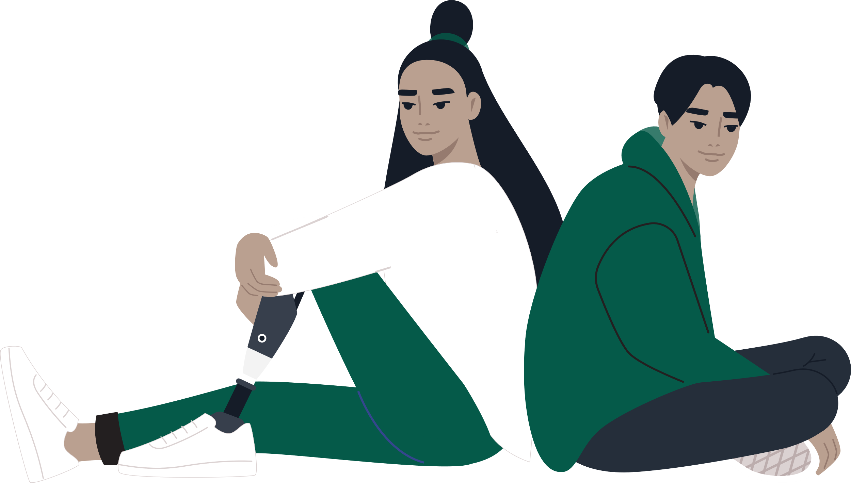
Stereotypes
Let’s look further into some of the ways media affects our views on relationships.
Do you think:
Girls only like guys who play sports and are fit?
Guys only like girls who are feminine?
To fit in you have to have a girlfriend or boyfriend?
Notes:
Slide intended to generate discussions
Things are not just black and white, there are different ways of looking at relationships.
Example: Some people enjoy having a lot of friends online and offline. Others enjoy fewer friendships with close connections. Both of these situations are fine, it is ok to be anywhere on this spectrum.

Slide 5
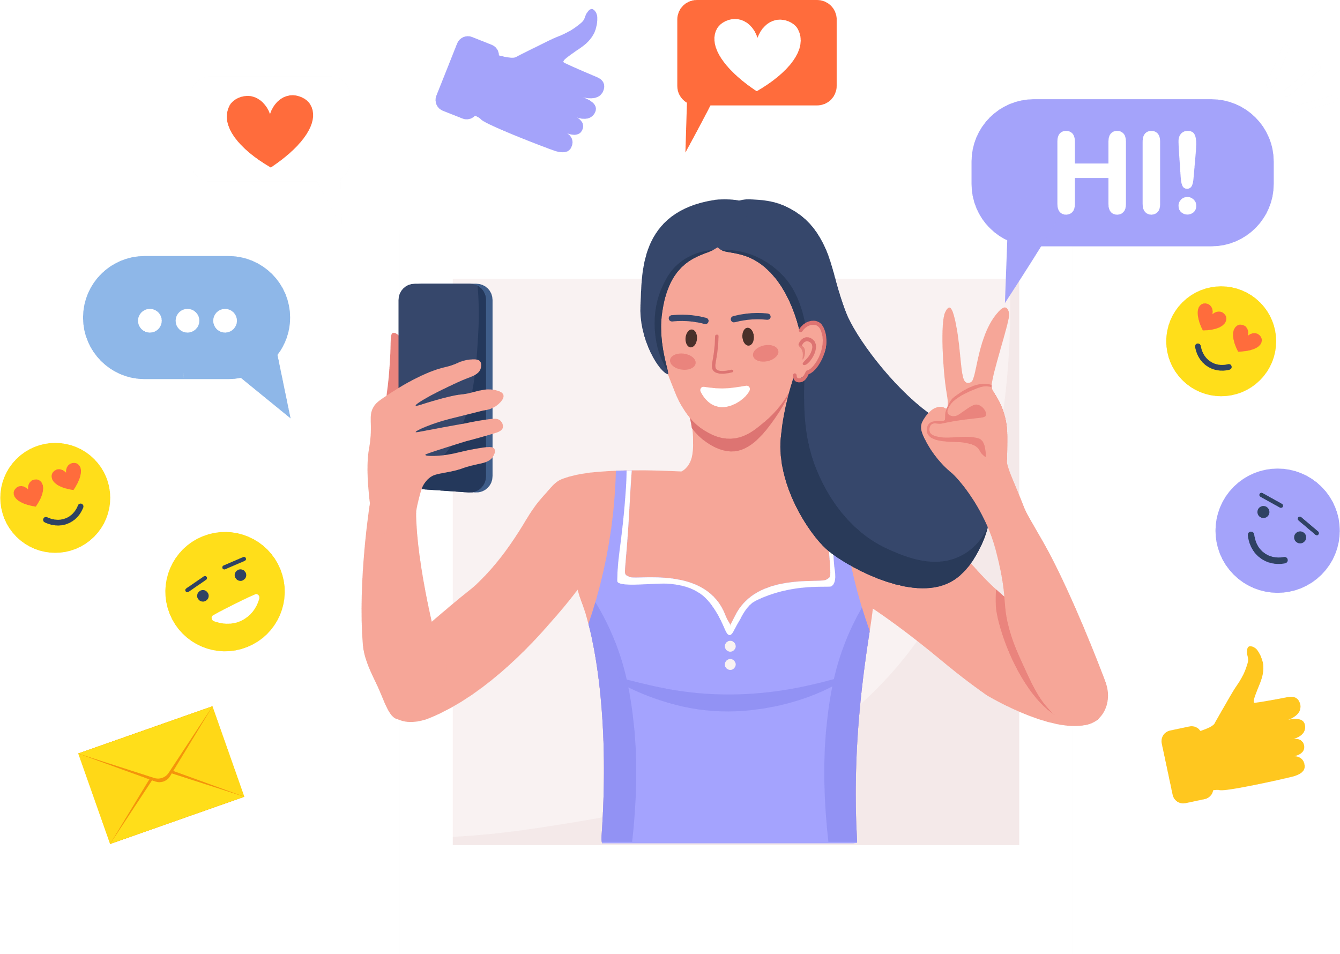
only popular people have lots of friends on social media
People who have lots of posts online are popular
Are there differences between “online friends” and “offline friends”?
Notes:
Continued from previous slide- meant to generate discussion

Slide 6
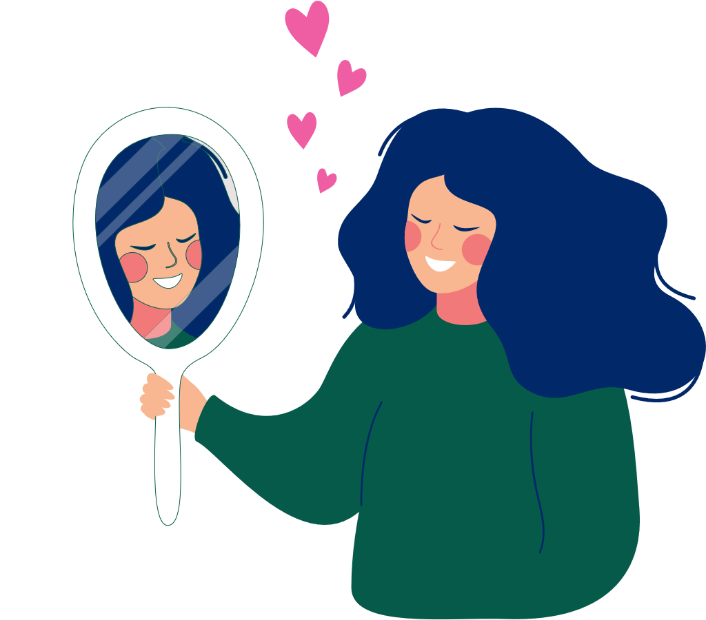
Healthy Relationships
Questions:
What do you remember from our first talk about healthy relationships?
Why is it important to talk about healthy relationships when we talk about social media?
Notes:
Teacher note: Just as we talked about how media can affect how we think, feel and act about relationships, social media can impact on our lives and relationships, which can be healthy or unhealthy. We are going to explore this and other aspects of social media in this presentation.

Slide 7
Pros of Social Media
News is shared instantly*
Promote/raise awareness for a cause
Can bring world to your doorstep
Notes:
*Notes: Sharing information immediately can be both a pro and a con, Why do you think this is the case?
or an event such as: Terry Fox run, trying to get more people involved in tree planting etc
information about other cultures, classroom pen pals)
Key points:
Keep in mind public Wi-Fi is not as safe as password protected Wi-Fi – unprotected can lead to hacking

Slide 8
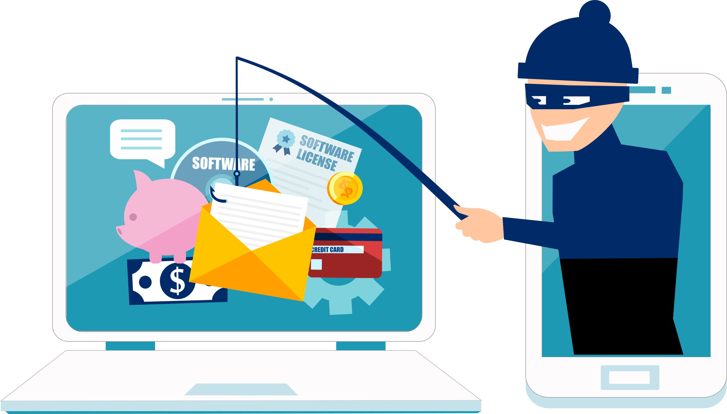
Cons of Social Media
News is shared instantly*
What you post is not “yours”
Identity theft/cat-fishing
Disclosing personal information
Hackers
Webcams
Emails
etc.
Notes:
Notes:* shared instantly is both pro and a con
-When you share photos on social media platforms it is an implied consent for use of your photos for advertising etc -Cat-fishing: someone using your personal photo and creating fake accounts pret
-Geolocations: understand which apps on your phone collect geolocations which can tell people you know and don’t know where you are. Smartphones have the ability to turn geolocations on or off.

Slide 9
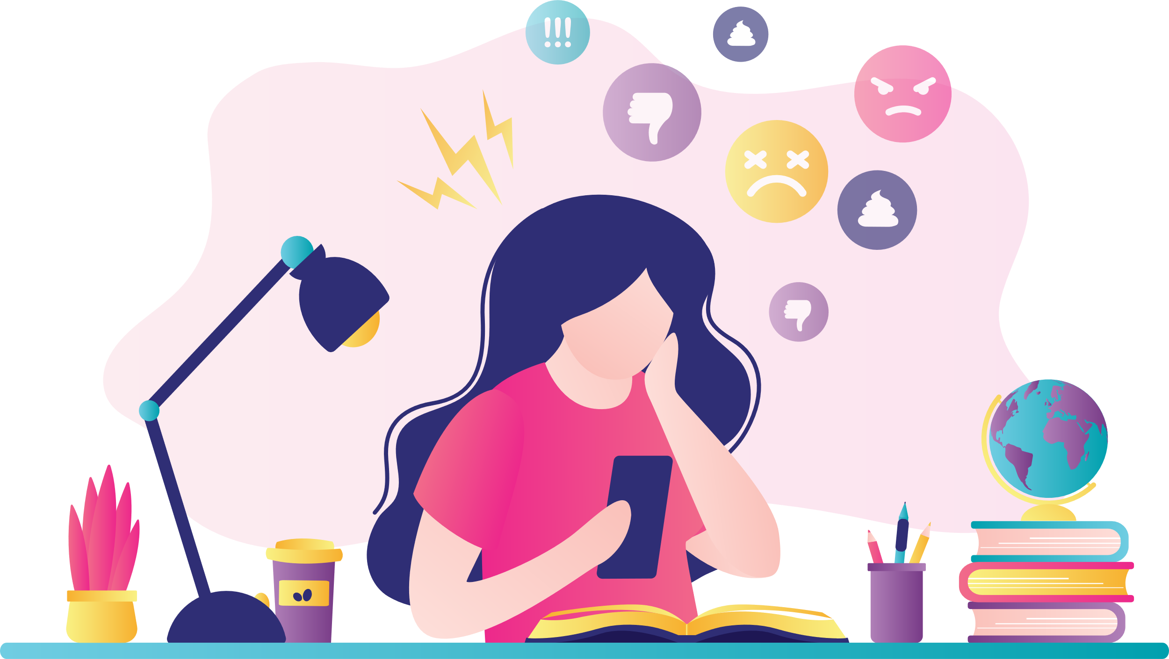
Online Scenarios
Adding people you don’t know on social media?
Sharing pictures that could get someone in trouble?
Playing an online game with friends and making fun of someone when they lose
Notes:
Teacher Note: This could be an opportunity to discuss multiple online safety issues/concerns as well as online bullying
. Some points to consider are:
Which of these scenarios could be considered online bullying?
What can be done to prevent online bullying?
What can be done to deal with online bullying?
Key messages:
Treat others online with respect like you would offline.
Don’t do anything online that you wouldn’t do in person or offline.
Remember it’s important to talk to a trusted adult if you are having an online problem.

Slide 10
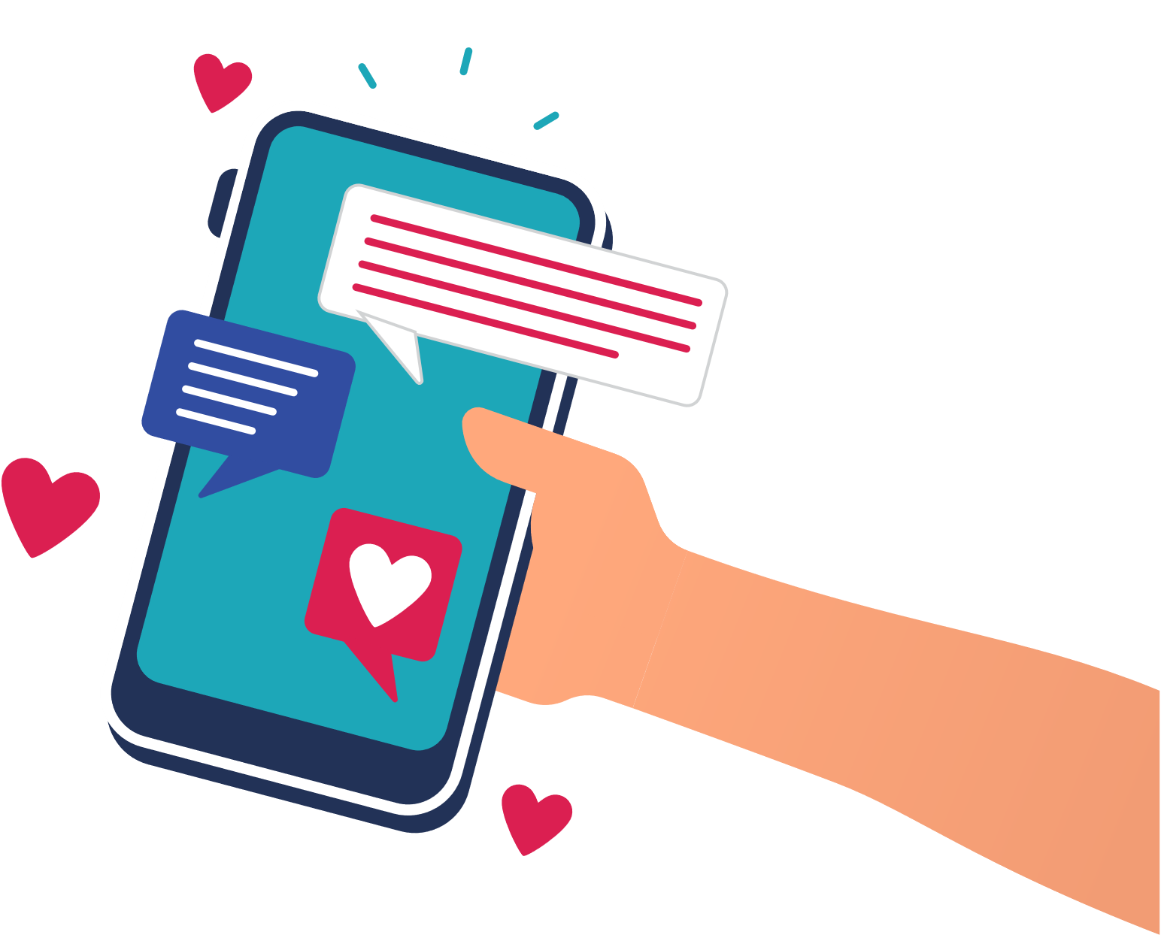
Sending a friend an e-card
Texting a friend a compliment
While gaming online with someone, you don’t know you discuss cheats- they offer to send the cheats but request your personal information

Slide 11
Manage Your Media
Take a step back and think: “Would a teacher, parent or grandparent think this is okay to say or share?”
Think ahead, be smart
The internet is public
The internet is permanent**
Things that you do on social media can cause problems for you now and later
Can affect your friendships
Can affect your chances of getting a job
Notes:
Key Points: The internet has the ability to present you in a certain way that doesn’t reflect who you are. Certain posts, pictures, conversations made public over the internet or social media can affect people’s reputations. These reputations can be carried with them throughout their lives and can be harmful.
**Overtime we are all making a ‘digital footprint’ which can affect our ‘digital well-being’.**
Teacher Resources: www.mediasmarts.ca includes information on:
Cyberbullying
Cyber security

Slide 12
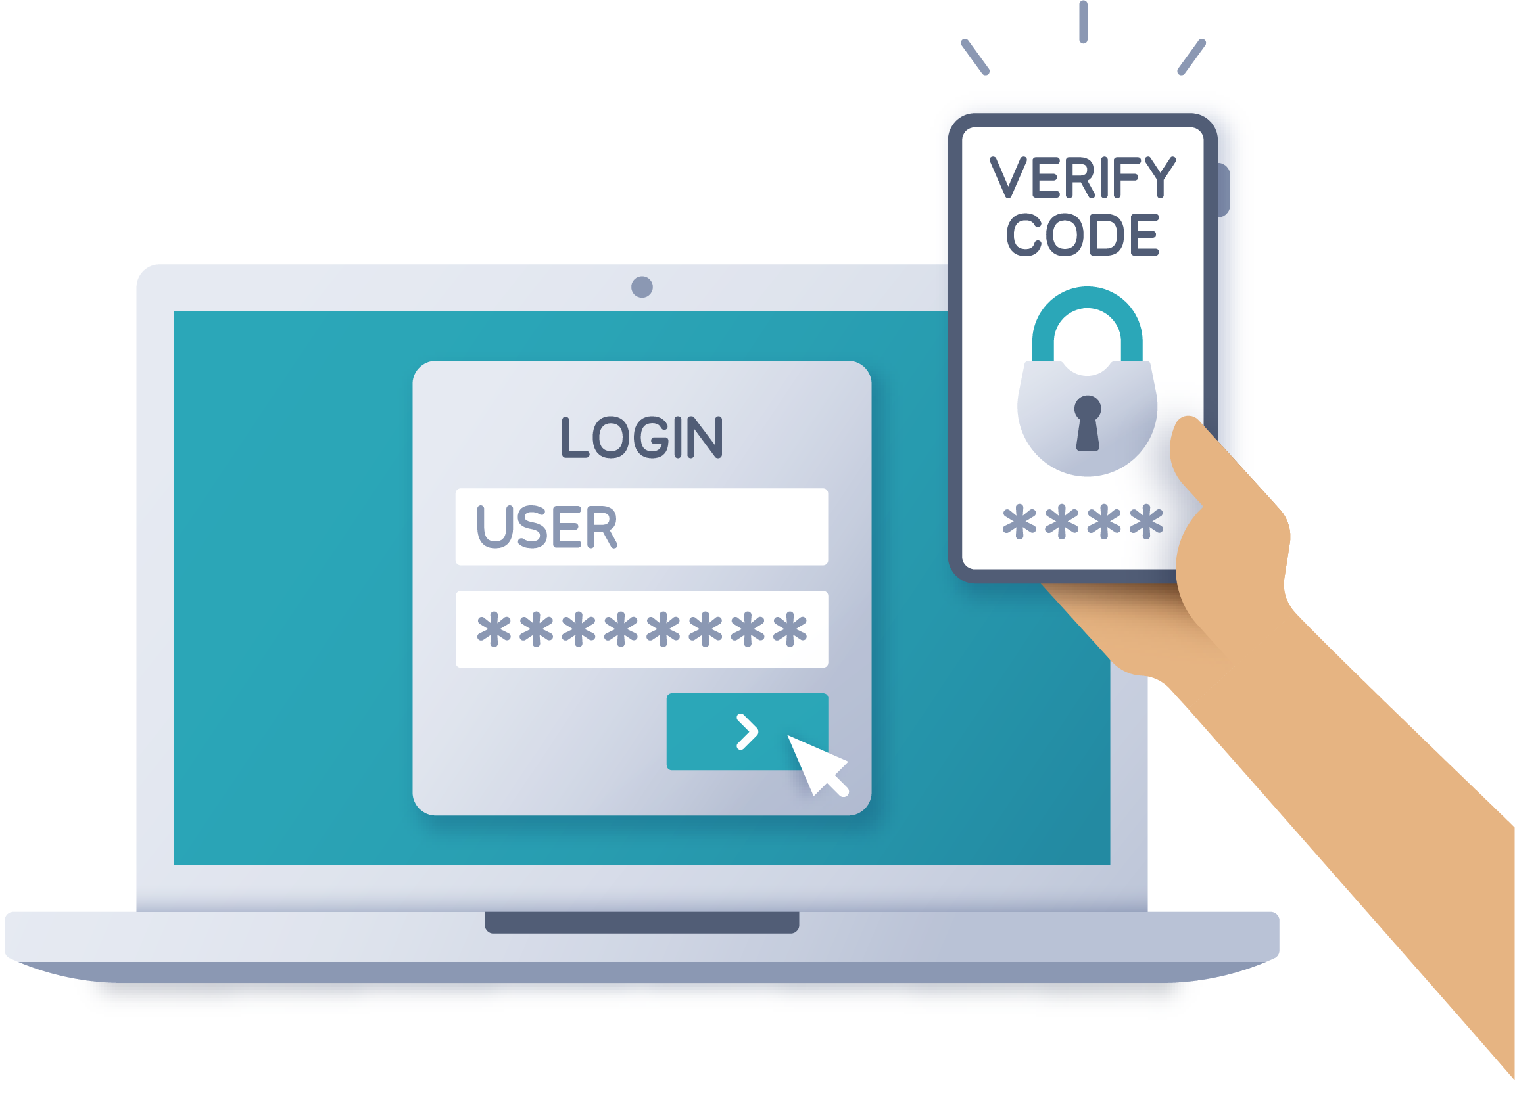
Manage Your Privacy
Make passwords hard to guess
Keep up to date with your account and privacy settings
Be cautious of what you say
For more information:
www.mediasmarts.ca
Notes:
Key Points:
Password encryption: Don’t share your password with friends. Make your passwords more secure by combining numbers, letters, upper case and lower case letters. For example: 1234 is a weak password versus rK4&qS
Account and Privacy settings: Keep track of your settings and review settings when website updates occur.
Be cautious of what you say:
Identifying geolocation
Pictures can provide information on where you are
You are not as anonymous as you may think (many things are traceable online).

Slide 13
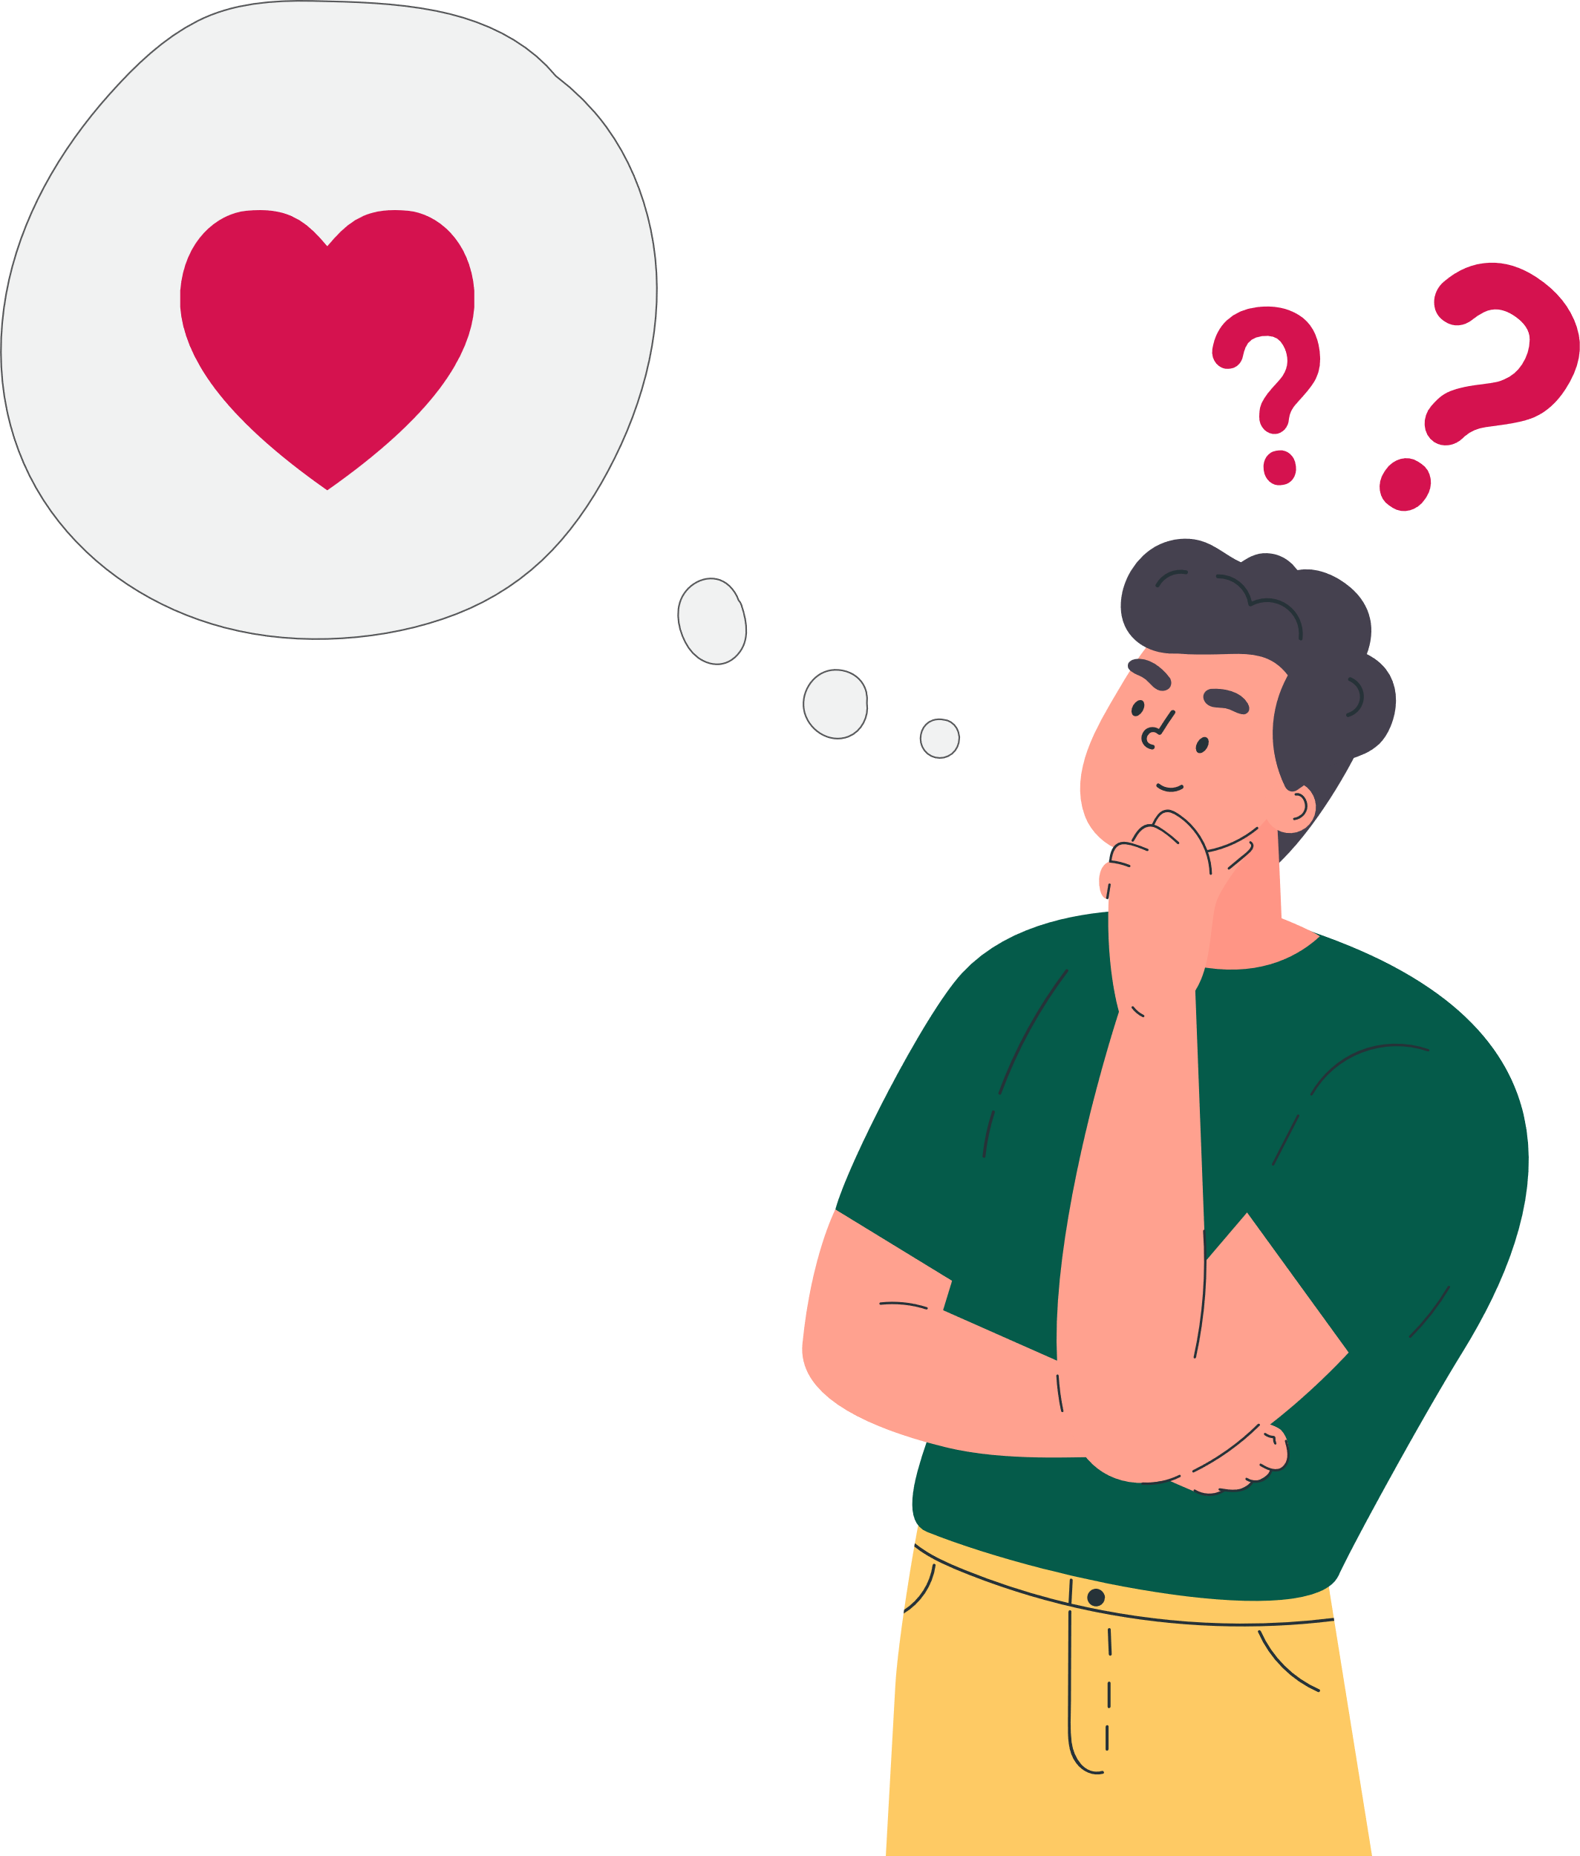
Romantic Relationships Activity
Dr. Lew’s Love Line “Positive Relationships”
Notes:
Teacher’s Note: Dr. Lew’s Love Line “Positive Relationships” :
https://s3.amazonaws.com/hwdsbcommons/wp-content/uploads/sites/9691/2018/02/Dr-Lews.pdf
Have students discuss these scenarios as a small group
Bring back to larger group discussion

Slide 14
Consent
YES
NO
Consent: What does it generally mean?
To agree to do or allow something
To give permission for something to happen or be done
Social Media Consent:
What are some ways people share pictures online?
Always ask before sharing a photo with others online.
You should not take a picture of someone and post it online without their consent.
It is illegal in Canada to distribute intimate images without consent*
Notes:
Teacher Note: For example, schools ask for consent before taking a picture of students. This respects peoples privacy options, understanding people feel differently about what images they do or don’t want to share.
*https://laws-lois.justice.gc.ca/eng/acts/C-46/section-162.1.html
outlines the offence and possible criminal charges as well as defines what an “intimate image” is according to the criminal code
Definition of consent from: http://www.merriam-webster.com/dictionary/consent

Slide 15
Sexual Consent
What can affect sexual consent decisions?
The effect of alcohol*
People can change their minds
Respect decisions without pressuring your partner
Stay true to self and your own morals, values, and beliefs
Notes:
*Can change how you think and behave
Some of your actions may be misunderstood as consent
Not in the right mindset to make a decision
FYI Important Definition of Sexual Consent:
*In Canada, anyone under the age of 12 cannot consent to sexual activity: anyone age 12 or 13 cannot consent to sexual activity with anyone 2 years or more older than them; and anyone age 14 or 15 cannot consent to sexual activity with anyone 5 years or more older than them. (Canadian Centre for Child Protection, 2013)

Slide 16
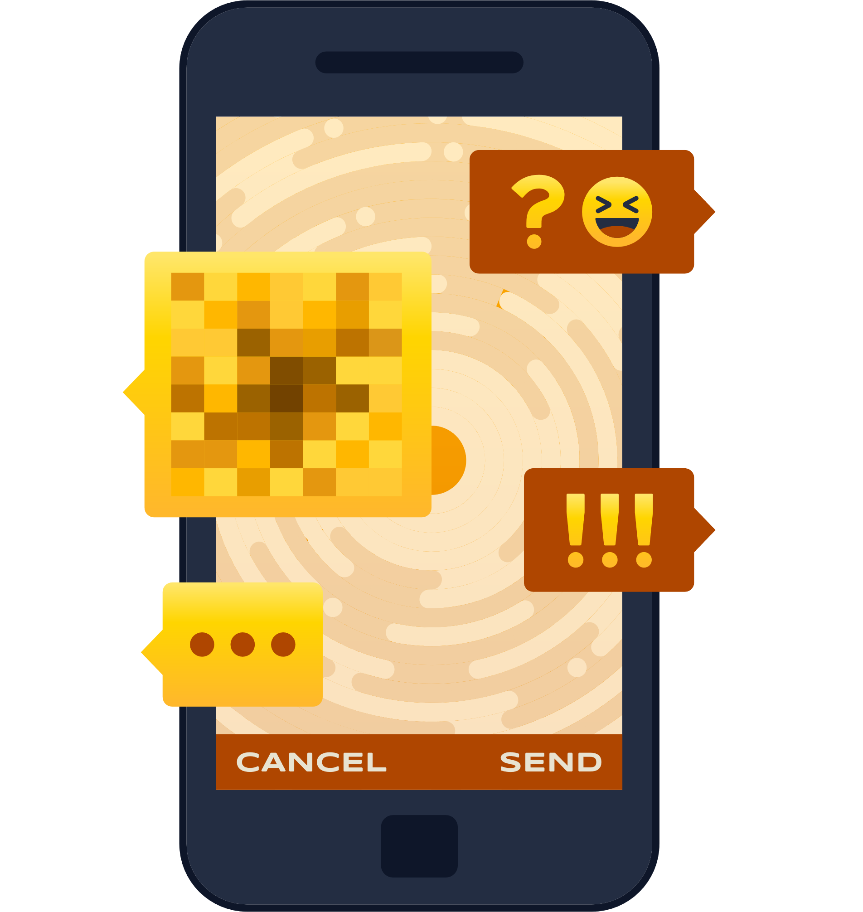
Sexual Health Scenarios Online
Consider these modern-day scenarios:
‘Sexting’
If someone asks you for a picture, how can you respond?
If someone sends you a picture, how can you respond?
Is this safe?
Notes:
Key Points:
It is a good to think about how you would respond to a situation if you felt pressured. For ideas on how to respond to a difficult request, in person or online, visit this website:
https://www.uen.org/lessonplan/view/28920
Follow link to above website-on click on Refusal Skills activity in the right hand side column. Provides statements and effective potential responses for scenarios
Cyberbullying:
The use of technology to verbally, socially or physiologically attack someone. It can involve all forms of technology including social media, internet gaming and mobile phone bullying. Cyberbullying is often repeated over time and involves some sort of abuse of power. Cyberbullying happens between close peer relationships and not usually with strangers – although they can get caught up in it.
You can refer to the different forms of cyberbullying which includes insulting, targeting, identity theft, uploading, excluding and harassment.

Slide 17
Smart Cell Phone Use
Set up a phone password with your parents and keep it private from others
Take time to think “would I say this in real life?” – think before you post
Tell an adult if you have messages/texts/ notifications from people or numbers you don’t recognize

Slide 18
Your tone of voice cannot be heard via text/message - things you say can be misunderstood
e.g. think about all the different ways you could read “Yeah, OK”
Use respectful language and pictures
Talk face-to-face for important conversations like:
A Disagreement with a Friend
Breaking up

Slide 19
Safety Pledge
Create your own safety pledge regarding cell phone/social media use
Examples of points you may want to include in a safety pledge:
I will always think before I post something online or share information
I will not pressure others to share something they are not comfortable with
I will let an adult know if I feel unsafe or uncomfortable about something that has happened online or offline
Notes:
Teacher note: Optional slide and classroom activity to apply student’s learning into their own lives both online and offline.
Please note: You can do an online search to find more ideas on safety pledges.
As a class or individually, come up with more ideas to create your own safety pledge. If completing this individually encourage students to share this with their parent or guardian.

Slide 20
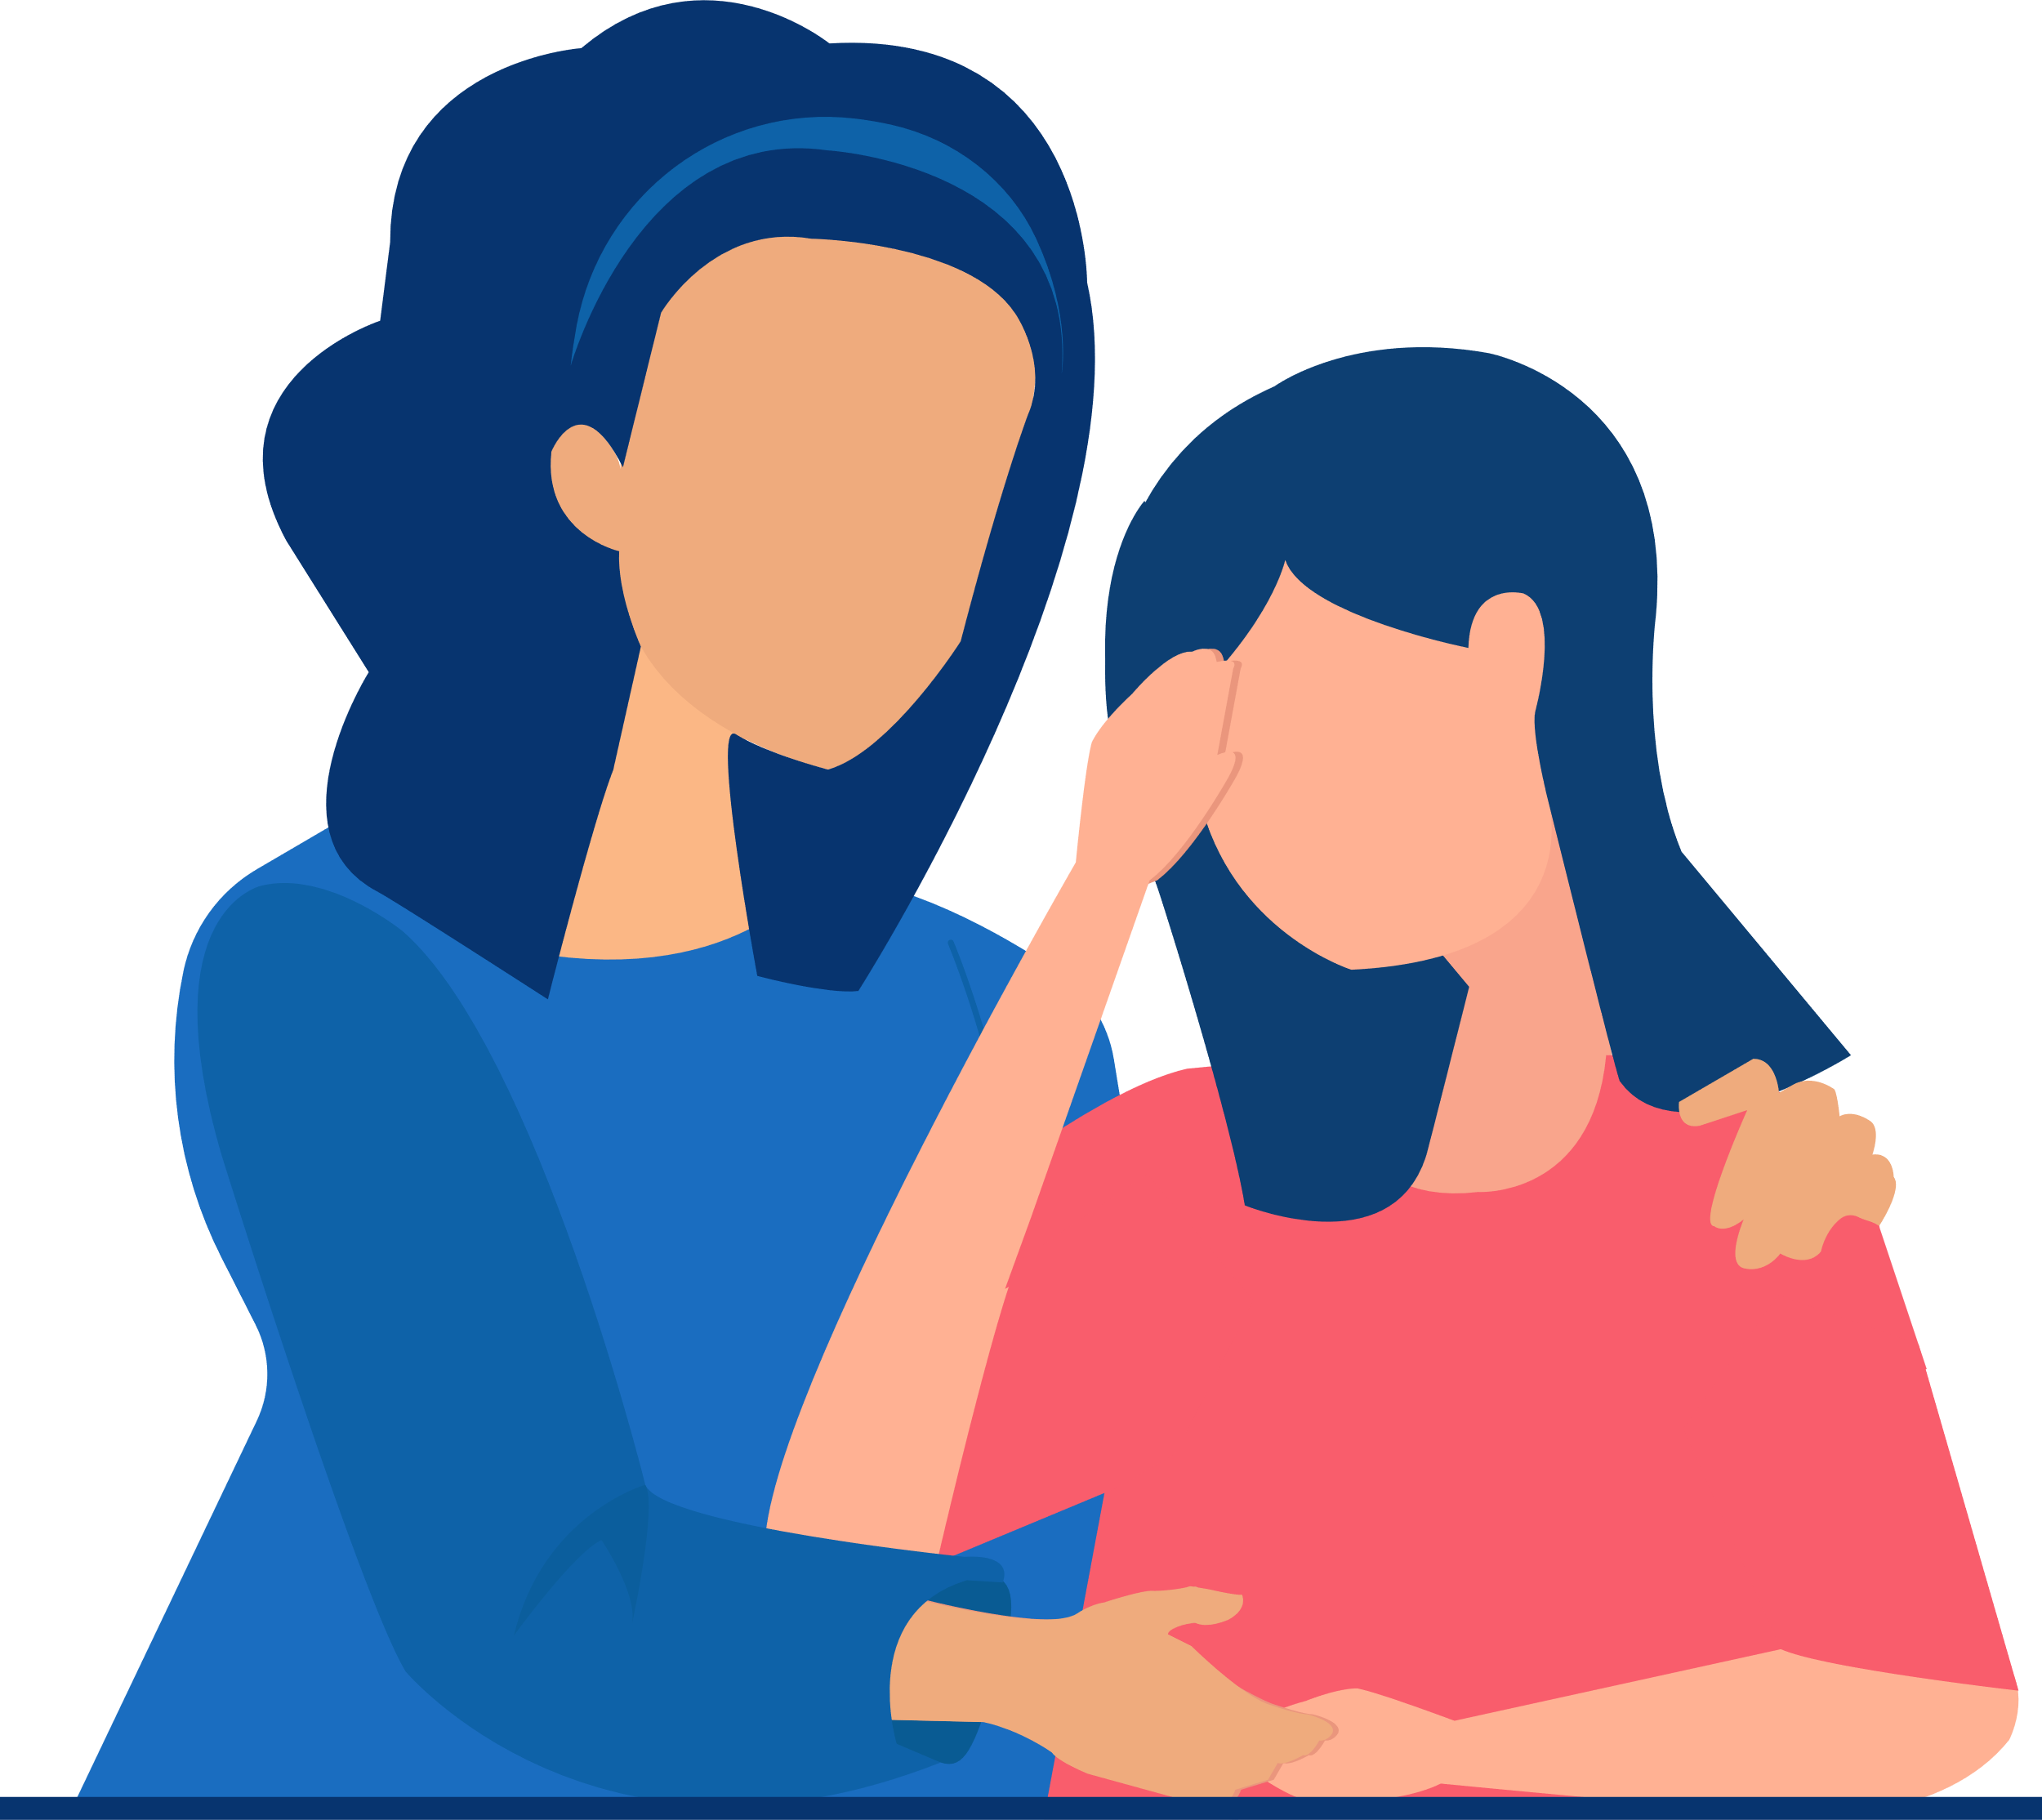
Where to Get Help
Talk to someone you trust
parent/guardian/older sibling
teacher
Kids Helpline 1-800-668-6868
www.NeedHelpNow.ca
Notes:
* Website: Need Help Now (Social media, bullying, unwanted pictures) http://needhelpnow.ca/app/en/
Keep in mind information shared online is public and permanent, but if you have had something posted online that you want to try and remove you can go to this website to try and minimize damage/take back control.
Image from: https://pixabay.com

Slide 21
Wrapping Up
Social media can affect our lives positively when we know how to manage it
Being aware of these concerns is the first step to protecting yourself
It is good to balance your online and offline relationships and surround yourself with positive relationships

Slide 22
Questions

